Slide 1
Sandboxed Solutions
Notes:
This module covers an important new way of allow customizations in SharePoint. The new Sandboxed Solutions feature allows solutions to be installed and deployed within a specific site collection instead of at the farm level.
Lecture 13: Sandboxed Solutions - 1

Slide 2
Outline
Application Hosting and Customization
Introducing Sandboxed Solutions
Executing Code in the Sandbox
Sandbox Resource Monitoring
Notes:
Lecture 13: Sandboxed Solutions - 2

Slide 3
Application Hosting and Customization

Slide 4

SharePoint 3.0’s Challenge
Developers build custom solutions
Administrators can only secure solutions with CAS
Hard to control what is being done in custom code
Biggest cause of SharePoint support cases: custom code
Developer
Design, build, and test customizations
Administrator
Install and monitor customizations
Site Collection Owner
Activate and use customizations
Notes:
The product SharePoint releases the burden on IT departments by allowing end-users to be manage the information structure.
This is an important part to the success of SharePoint, the core concept of sites, lists and libraries and provisioning.
However, the real value lies in the customizations that enable you to maximize the potential that sits in the templates provided by SharePoint.
In SharePoint 2007 you still need IT to install and maintain these customizations. This slows down business and impacts IT unnecessarily.

Slide 5
SharePoint 2010 Approach
Developers build custom solutions
Site collection owners deploy, activate and implement the customizations
Administrators leverage resource monitors to check site collection usage
Automatic triggers “turn off” custom solutions in a site collection that are too expensive and taxing on the server
Developer
Design, build, and test customizations
Administrator
Monitor customizations
Site Collection Owner
Deploy, activate and use customizations
Notes:
SharePoint 2010 allows customizations to be deployed and maintained at the site collection level.
Increasing agility while releasing burden on IT.
Of course there is still IT involvement, but mainly when things go wrong (such as excessive resource usage).

Slide 6
Introducing Sandboxed Solutions

Slide 7
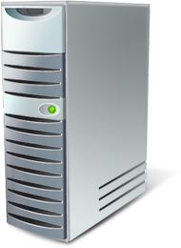

Sandboxed Solutions
Allow a subset of ‘full’ solution features
Code executes in sandbox
Are deployed by a Site Collection administrator
Stored in the Solution Gallery
Notes:
A SharePoint solution has two sides to it.
The declarative CAML used to create many components such as list templates and content-types, and
The code side in workflow, event receivers or Web Parts.
Sandboxed solutions can contain all these elements.
The solutions are deployed to a special gallery which sits under _catalog like the other built-in galleries.
Lecture 13: Sandboxed Solutions - 7

Slide 8
Introducing Sandboxed Solutions
Sandboxed solution: site collection owners can upload to SharePoint
Empowers site collection owners to deploy new functionality w/o involvement of IT
Local/remote development options
Self-regulating and monitored by IT
Limited set of permissions & functionality
Resource quotas established & monitored by IT
Secure: site collection owner is in control
Notes:
Sandboxed solutions allow admins allow more custom code deployment flexibility by site collection owners, at the same time putting up guards to protect the server

Slide 9
Sandboxed Solutions Help Enterprises
Sandboxed solutions are important because
Solve SharePoint hosting issues in corporate environments
Hosted environments much easier to manage
Reduces time to deploying custom solutions
Removing process of getting code approved and deployed by IT
Improves stability of SharePoint servers
Now badly performing code isolated to site collection rather than potentially bringing down an entire server
Notes:
Site collections are empowered to deploy custom code that will run within a sandbox thus not hurt the system; no longer need to get admins involved in deployment

Slide 10
Overview of the Sandbox
Allows a subset of the full capabilities in the SharePoint API
Secure – enforcing the sandbox
Execute in a partially trusted environment
Code executes in a special service process
Subject to CAS
Validation framework
Provides way to do custom farm wide validation for the deployed packages
Each solution is isolated to its site collection
Notes:
This slide explains the essence of a sandbox

Slide 11
Sandboxed Solution Lifecycle
Installation
Upload into Solution Gallery
Solution is validated upon installation
Activation
Auto-activates features
Deactivation
Inert operation, extended by developer
Web Parts no longer execute
Deletion
Notes:
The way people install and interact with a sandboxed solution is similar to normal solutions, but automated a bit.
Important concept to hit is the fact that solutions get validated before they are allowed to be installed, and that you can extend this validation.
After installation the solution is activated, which auto-activates features.
Deactivation is a different story. The main thing that is visible are Web Parts executing from the sandbox. They will no longer execute.
If you re-activate the solution the Web Parts will start executing again.
You can change the behavior using feature receivers.
Lecture 13: Sandboxed Solutions - 11

Slide 12
Sandboxed Solution Elements
Web Parts
Lists
List Templates
Custom Actions
Workflows
Event Receivers
Content Types
Site Columns
…
Notes:
Generally you can do most things you can with full solutions, at least those within the context of a site collection. You cannot deploy files on disc or assemblies to the GAC.
Lecture 13: Sandboxed Solutions - 12

Slide 13
Installing & Running Sandboxed Solution
demo
Notes:
Lecture 13: Sandboxed Solutions - 13

Slide 14
Executing Code in the Sandbox

Slide 15
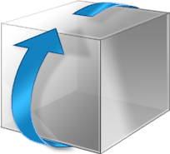





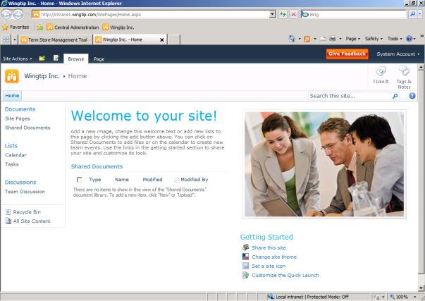



Sandboxed Solutions Process
Root SPWeb of SPSite
Per-WFE AssemblyCache
1
Solution gallery
5
<siteguid>\company. intranet.webpart.wsp\ company.intranet.dll
WebParts.wsp
2
Web Part gallery
6
4
Sandboxed Code Serice
3
7
Notes:
This chronicles the process of using a custom "bugs" Web Part and solution in a particular site.
The SPSite admin uploads a new solution package (*.wsp) into the Solution Gallery of the SPSite.
The SPSite admin "activates" the solution. This activates the features within the solution. Web Part files are copied into the Web Part gallery.
As part of the activation, solution is validated using the validation framework. Custom validator can be added for example to check that only solutions signed with certain key can be activated. Customers and partners can develop their own validators based on their needs.
Some time later, a user decides to add a Web Part to their home page. They go into Web Part edit mode, and click "Add a Web Part". They notice the additional Web Part options, and click Add.
SharePoint now checks to see if the bugs.dll file, which backs this Web Part, is installed into the assembly cache. It is not.
The assembly is faulted into the assembly cache; it is extracted and copied from the solution file to temporary folder in disk and loaded to memory (disk is cleaned immediately). Now the Web Part is about to be used.
It is loaded into Sandbox Code service host.
Processes deliver the Web Part to be executed to the service.

Slide 16
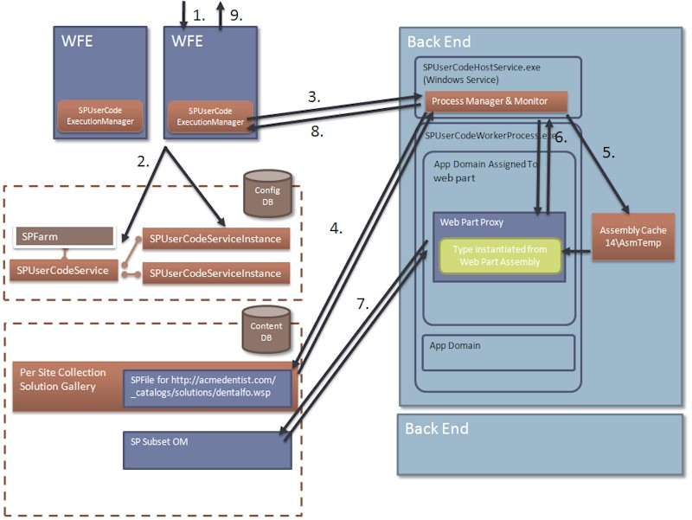
Sandbox Solution Execution Details
Notes:
An incoming request comes in for a page with a Web Part from a partial trust assembly. This is delegated to a Web Part proxy. The Web Part proxy then in turn calls the worker process manager, and tells it to execute the Web Part.
The worker process manager queries the configuration database to figure out which machine and process it should send the request to.
The worker process then sends the request to the user code manager on that machine.
The user code manager needs to ensure that the assembly backing the Web Part is locally deployed. To do this, it reaches back into the Web Part solution package, extracts the assembly, and places it into the assembly cache.
Now, the SPUserCodeManager (SPUserCodeHostService.exe) delegates the request to execute the code to SPUserCodeWorkerProcess.exe. The full trust Web Part wrapper works with the instantiated process to simulate the Web Part lifecycle.
The Web Part itself calls into the SharePoint OM to retrieve some set of data.
The resulting HTML and viewstate changes are bubbled back to the hosting process, which has been synchronously waiting for this infrastructure to complete.
The resulting page is sent back to the user.
Rendered results sent back to the requester.

Slide 17
The Subset Object Model
In general
SPSite and below
No SPSecurity
No SPSite construction
SPSite
SPWeb
SPList
SPListItem
Notes:
This slide discusses the capabilities of the subset object model.
The Subset Object model is a subset of the full SharePoint 2010 Object Model and is made available to code executing within the security sandbox.
Generally the Subset OM contains classes for content below the SPSite, except for security sensitive classes such as auditing and SPSecurity.
Visual Studio 2010 filters IntelliSense based on whether you develop a full-trust or sandboxed solution.
Lecture 13: Sandboxed Solutions - 17

Slide 18


Sandbox and Code Access Security
AspNetHostingPermission, Level=Minimal
SharePointPermission, ObjectModel=true
SecurityPermission, Flags=Execution
Sandbox
My.dll
User Code
wss_usercode.config
Other.dll
System DLL
SharePoint DLL
Framework Code
Full Trust
SharePoint OM
API Block List
Notes:
Code is executed in a sandbox protected through CAS.
There are two general policies.
The first applies to Microsoft SharePoint DLLs, giving them full-trust (including the Subset OM),
The other applies to all other code. You are given very strict permissions.
In order to shield from lurking dangers in the SharePoint object model, SharePoint has a concept of a API Block List that allows further restrictions on the APIs a sandboxed piece of code can call.
Lecture 13: Sandboxed Solutions - 18

Slide 19


Compiling vs. Executing Sandboxed Solutions
MyWebPart.dll
Visual Studio 2010 uses IntelliSense to hide full-trust types
All code is compiled against the full API
Thus, no “sandbox” check at compile time… only at runtime
Workaround: change the Microsoft.SharePoint.dll project reference to reference the sandbox’s version
[..]\14\UserCode\Assemblies\Microsoft.SharePoint.dll
NOTE: Switch it back before deployment!
Use this as a temporary test - do not deploy code that references the sandbox’s assembly
Runtime
Full Object Model
Subset Object Model
Proxy
Notes:
Visual Studio 2010 prompts developer is solution is full/sandbox… this simply sets a bit in the *.csproj.user file.
This tells VS to use a specific IntelliSense file that includes the subset of what you can use.
However, developers can still type the blocked calls, such as SPSecurity.RunWithElevatedPrivlidges(), and successfully copile.
At runtime the link will be resolved against either the subset object model, or against the full object model depending on the type of solution. Calls to SPSecurity will fail at runtime when you are sandboxed.
This can be a challenge for developers who copy-paste code samples from what should be full trusted solutions, or upgrading existing projects.
WHY? Only at RUNTIME will users find out they can’t do specific things because there is no COMPILETIME check
WORKAROUND: change the Microsoft.SharePoint.dll project reference to use the sandbox proxy assembly: [..]\14\UserCode\Assemblies\Microsoft.SharePoint.dll
NOTE: do not deploy code referenced against this assembly… the workaround should only be a check & temporary.
Lecture 13: Sandboxed Solutions - 19

Slide 20
Creating a Sandboxed Solution with VS 2010
demo
Notes:
Lecture 13: Sandboxed Solutions - 20

Slide 21
Sandbox Resource Monitoring

Slide 22
Sandbox Solution Monitoring
Site collection quotas specify the warning and hard limits for number of resources that can be used per day
Sum of resource measures are taken across solutions deployed to site collection
i.e.: add up CPU Points for all solutions
Max of resource utilization measures checked against site collection quota to determine if it should be throttled/blocked
Notes:
Resource monitors keep sandbox solutions from over taxing the server.
The SUM of all resource measures is the number applied to the quota.
The MAX of all resource measures is used to determine if the sandbox should be turned off for a given solution one day.

Slide 23
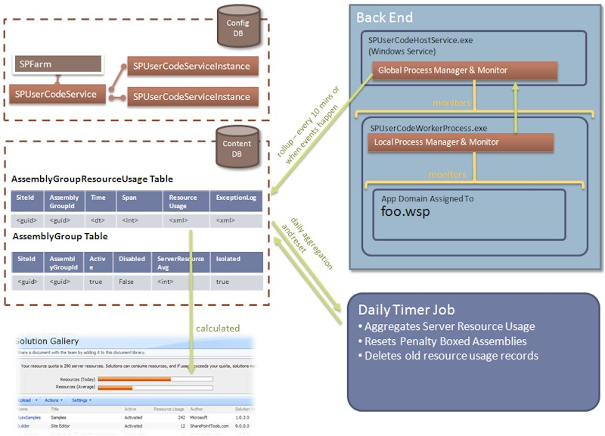
Resource Monitoring Processing
Notes:
Resource points aren’t calculated immediately… they are a bit delayed
A sandbox solution will never shut off in mid-process...
The resource counters recycled nightly by a timer job (default = midnight of the server the timer job runs on)

Slide 24
Monitored Resources
Metric Name | Description | Units | Resources Per Point | Hard Limit
AbnormalProcessTerminationCount | Process gets abnormally terminated | Count | 1 | 1
CPUExecutionTime | CPU exception time | Seconds | 3,600 | 60
CriticalExceptionCount | Critical exception fired | Number | 10 | 3
InvocationCount | Number of times solution has been invoked | Count | N/A | N/A
PercentProcessorTime | Note: # of cores not factored in | Percentage Units of Overall Processor Consumed | 85 | 100
ProcessCPUCycles |  | CPU Cycles | 1E+11 | 1E+11
ProcessHandleCount |  | Windows Handles | 10,000 | 1,000
ProcessIOBytes | (Hard Limit Only) Bytes written to IO | Bytes | 0 | 1E+08
ProcessThreadCount | Number of Threads in Overall Process | Threads | 10,000 | 200
ProcessVirtualBytes | (Hard Limit Only) Memory consumed | Bytes | 0 | 1E+09
SharePointDatabaseQueryCount | SharePoint DB Queries Invoked | Number | 20 | 100
SharePointDatabaseQueryTime | Amount of time spent waiting for a query to be performed | Seconds | 120 | 60
UnhandledExceptionCount | Unhanded Exceptions |  | 50 | 3
UnresponsiveprocessCount | We have to kill the process because it has become unresponsive | Number | 2 | 1
Notes:
Resource Per Point is how much this contributes to the point limit per day for the site collection
Hard Limit is how much of this resource a solution can use in a single invocation before it is terminated – a maximum use of quota in a single invocation
Invocation count is used to measure the per-instance cost of a solution for purposes of reporting and assigning to run-time “tiers” for farms that want to separate solutions into multiple different sandbox processes – there is only one by default.

Slide 25
Sandbox Solution Monitoring Case Study
Web Part in a sandbox solution executes 40 SQL queries (via the SharePoint OM)
20 SQL Queries = 1 point (default)
Resource usage for this Web Part for the day:
= (2 points * # of executions throughout the day) + other counters
OOTB resource quota = 300, so one execution of this Web Part = 0.67% of site collection’s daily allocation

Slide 26
Managing Sandbox Solutions
Configure site collection quotas from Central Administration
Site collection owners can manage and view resource usage from Site Settings » Solution Gallery
PowerShell administration
Get-SPSite | foreach-object {$_.Quota.UserCodeMaximumLevel = 300}
Get-SPSite | foreach-object {$_.Quota.UserCodeWarningLevel = 100}
You can also block completely certain solutions in farm level
Can be managed from Central Admin level
Notes:
Management of sandbox solutions is handled through resource quotas, similar to site quotas
Scoped at the site collection
When sandbox goes over it’s resource allocation, all solutions are blocked from executing in the sandbox for remainder of the day
Management is done through Central Administration or PowerShell

Slide 27
Load Balancing
Sandboxed solutions can be run in two modes:
Local Mode:
Execute code on WFE
Low administration overhead
Lower scalability
Remote Mode:
Execute on dedicated SharePoint servers
Load balanced distribution of code execution requests
Create custom Load balancers
Notes:
Code can either be executed locally on the machine that receives the request, or on a load-balanced back-end server. The User Code Service needs to run on the machine executing the request.
Lecture 13: Sandboxed Solutions - 27

Slide 28
Solution Validation
Restrict the solutions that are allowed to run
Install with a farm level feature
[GuidAttribute("34805697-1FC4-4b66-AF09-AB48AC0F9D97")]
public class PublisherValidator : SPSolutionValidator{
[Persisted]
List<string> _allowedPublishers;
public override void ValidateSolution(
SPSolutionValidationProperties properties){
}
public override void ValidateAssembly(
SPSolutionValidationProperties properties,
SPSolutionFile assembly){
}
}
Notes:
A solution validator is a normal SPPersistedObject and needs to be handled as such. The validator is called when it is installed (on all items) and when a solution is installed or changed.
Lecture 13: Sandboxed Solutions - 28

Slide 29
Exploring Central Administration & Solution Gallery
demo
Notes:
Lecture 13: Sandboxed Solutions - 29

Slide 30
Summary
Application Hosting and Customization
Introducing Sandboxed Solutions
Executing Code in the Sandbox
Sandbox Resource Monitoring
Notes:
Lecture 13: Sandboxed Solutions - 30

